Slide 1
Digital Marketing Campaign Analysis

Slide 2
Agenda : Enhance campaign effectiveness in digital marketing by predicting customer conversions.
Objectives:
Enhance campaign effectiveness in digital marketing by accurately predicting customer conversions.
Develop a machine learning model to identify potential converters.
Improve targeting of marketing efforts to increase efficiency.
Enable data-driven decision-making in marketing strategies.
Understand key factors influencing conversions to design more effective marketing campaigns.

Slide 3
Data Preprocessing
Loading Data: Loaded dataset from an Excel file.
Handling Missing Values: Dropped rows with missing values.
Encoding Categorical Variables: Used LabelEncoder to convert categorical variables to numerical values.
Scaling Numerical Features: Applied StandardScaler to standardize numerical features.
Splitting Data: Using Stratefied Sampling method to Split data into training and testing sets (70/30 split).

Slide 4
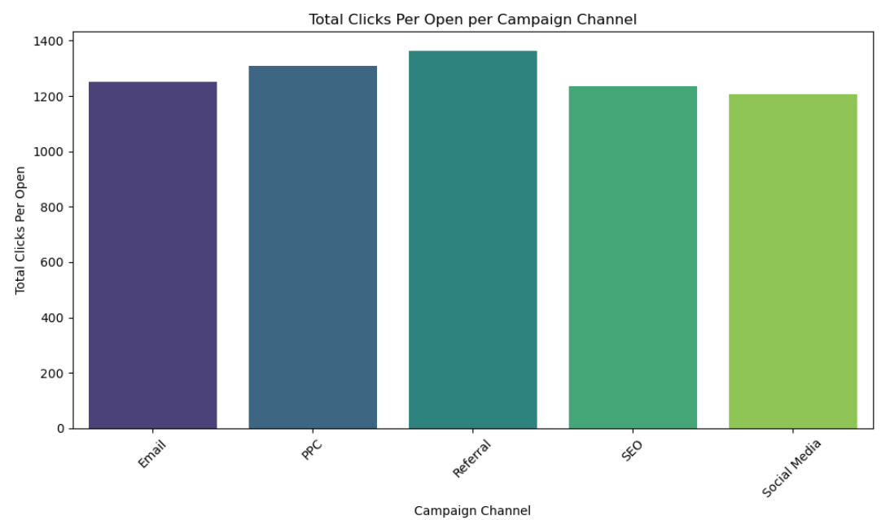
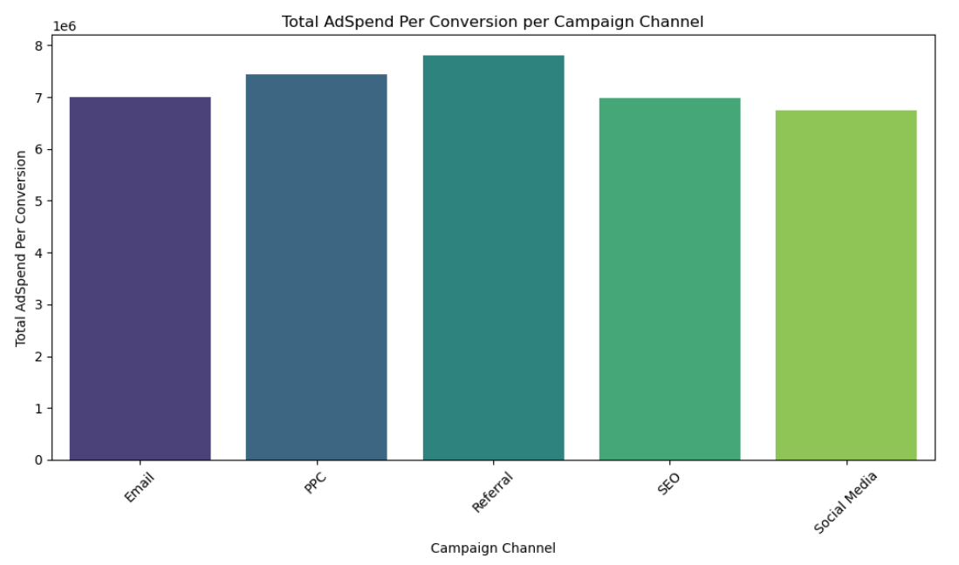
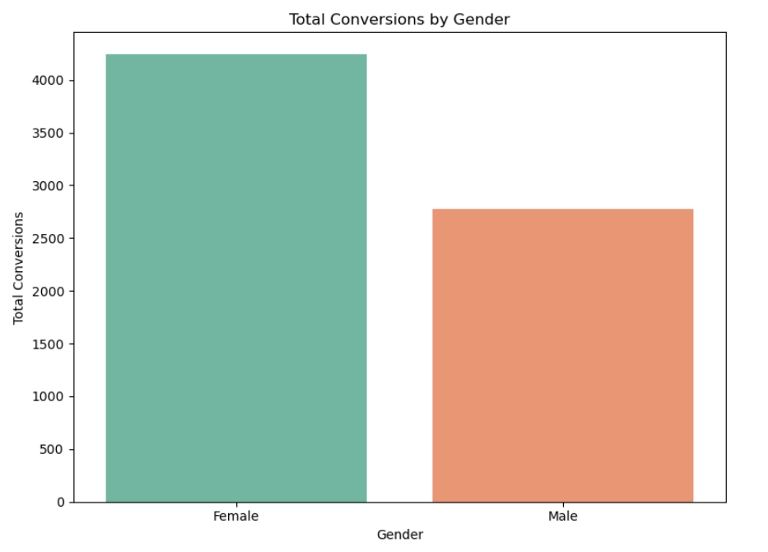
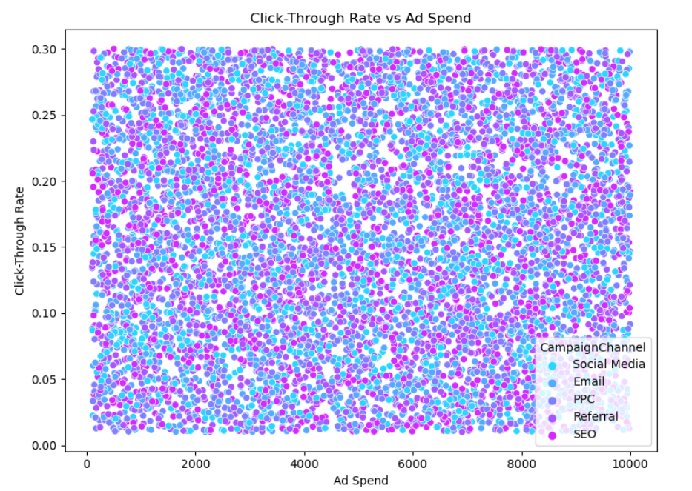
Exploratory Data Analysis (EDA)
Key Visualizations:
Total Clicks per Open per Campaign Channel: have created new feature and Identified the quantum of opened mail has performed clicks on Campaign Channel
Total AdSpend per Conversion per Campaign Channel : Identified the quantum of conversion made from Adspend over Campaign Channel by creating a new feature.
Total conversion by Gender: Identified the audience action based on Gender
Click through rate vs AdSpend: Visualized Scatter plot on Click through rate vs ad spend.

Slide 5
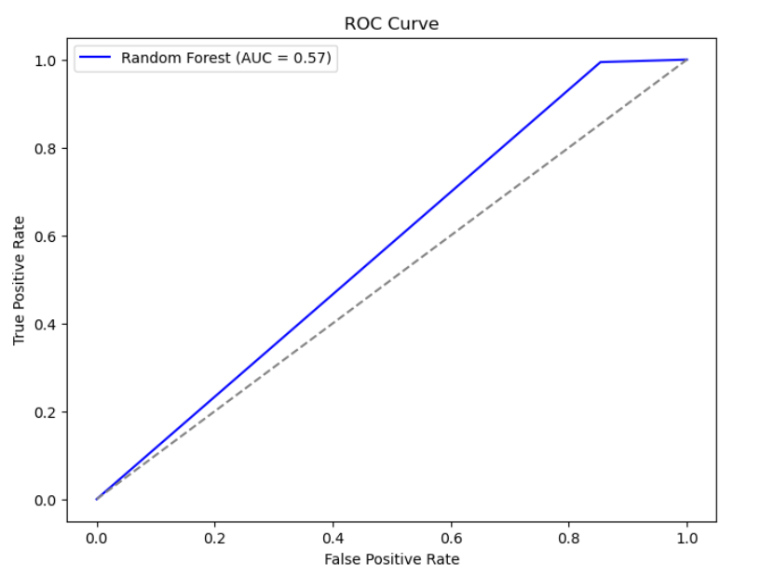
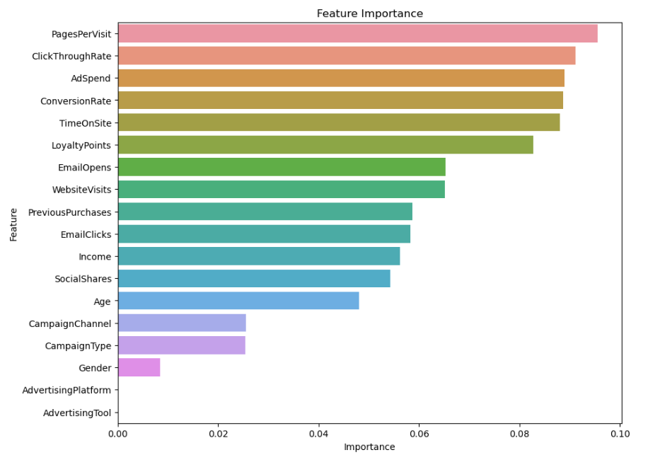
Model Building, Evaluation & Interpretation
Model Selection: Evaluated various classifiers, started with Random Forest.
Training the Model: Used training data to train the Random Forest classifier.
Making Predictions: Predicted conversion outcomes on test data.
Classification Report: Show precision, recall, F1-score for each class.
Accuracy Score: Present overall accuracy of the model. And Plotted the AUC for random forest Classifier
Feature Importance: Visualized the importance of each feature in predicting conversions using a bar chart. On selecting few major feature have created a new feature to get insights over the campaign channel performance

Slide 6
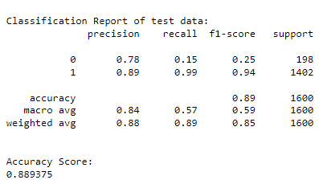
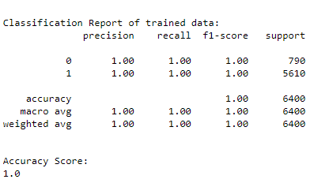
Findings and Predictions :
Total clicks per opens: Clicks/Opens are higher for the referral campaign channel .
Conversion/Gender: We have coversion rates higher for female than male
Model Predictions: Successfully predicted customer conversions with an accuracy of 88% on test
Findings : The performance of male audience is lesser need to improve the targeting audience to get more conversion.

Slide 7
Thank You!

